Slide 1
MODULE 2
PRINCIPLES OF PIPELINING

Slide 2
Introduction
Pipelining offers an economical way to realize temporal parallelism in digital computers.
To achieve pipelining, one must subdivide the input task into a sequence of subtasks, each of which can be executed by a specialized hardware stage that operates concurrently with other stage.
Widely used in application-specific machine where high throughput is needed
Can be incorporated in various machine architectures (SISD,SIMD,MIMD,.....)

Slide 3
Principles of Linear Pipelining
A. Basic Principles and Structure
Let T be a task which can be partitioned into K subtasks according to the linear precedence relation:
T= {T₁,T₂,..........,T_{k}} ; i.e., a subtask T_{j} can not start until { T_{i} ∀ i < j} are finished. This can be modelled with the linear precedence graph:

Slide 4
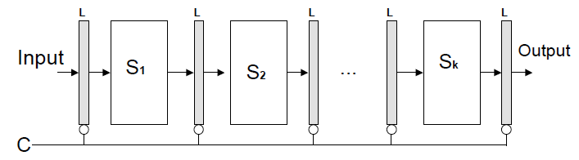
B. Basic Structure and Control of a Linear Pipeline
Processor
(L=latch, C=clock, Si=the ith stage.)

Slide 5
Latches are fast registers to hold the intermediate data between the stages.
Informational flow is controlled by a common clock. with some clock period “τ”, and the pipeline runs at a frequency of 1/τ
τ is selected as:
τ = MAX{τ_{i}} + τ_{L} = τ_{M} + τ_{L}
where, τ_{i}= propagation delay of stage Si
τ_{L}=latch delay
Thus,
Pipeline clock period is controlled by the stage with the max delay.
Unless the stage delays are balanced, one big and slow stage can slow down the whole pipe.

Slide 6
C.Space-Time Diagrams
Consider a four stage linear pipeline processor and a sequence of tasks such as T₁, T₂,...etc.
Here each task has 4 subtasks
T₁=>{T₁₁,T₁₂,T₁₃,T₁₄}
T₂=>{T₂₁,T₂₂,T₂₃,T₂₄}
...
T_{n}=>{T_{n1},T_{n2},T_{n3},T_{n4}}
A space-time diagram can be constructed to illustrate how the overlapping execution of the tasks as follows

Slide 7
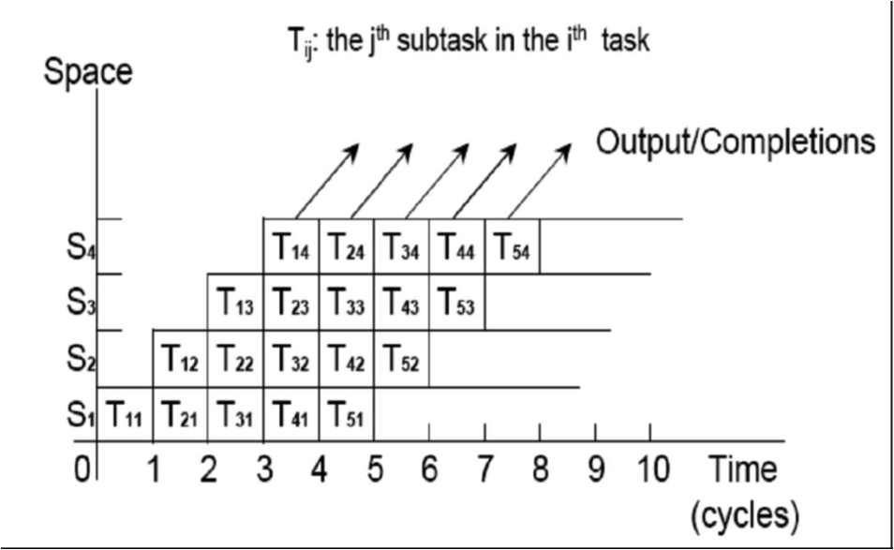
Time-space diagram depicting the overlapping operations.

Slide 8
Performance Measure for Linear Pipelined Processors
Once the pipe is filled up, it will output one result per clock period independent of the number of stages in the pipe.
A linear pipeline with k stages can process n tasks in
  T_{k}=k+(n-1) clock periods,
  where k cycles are used to fill up the pipeline or to complete execution of the first task and n-1 cycles are needed to complete the remaining n-1 tasks.
The same number of tasks can be executed in a nonpipeline processor with an equivalent function in T₁ =n.k time delay.

Slide 9
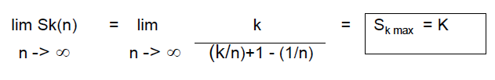
Speedup S_{k}- the speedup of a k-stage linear pipeline processor (over an equivalent non-pipelined) is given by
S_{k}=(T)/(T_{k}) =Execution time for the non-pipelined processor
Execution time for the pipelined processor
= n.k
k+(n-1)
The maximum speedup, attained after an infinite no of tasks is
The maximum speedup is never fully achievable because of data dependencies between instructions, interrupts, program branches etc.

Slide 10
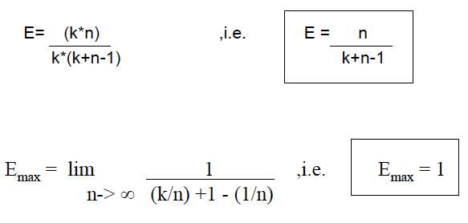
Efficiency “E” - the ration of the busy time span over the overall time span.
» Overall time span =(no of stages) * (total no of clocks)
= k*(k+n-1) clock.stage
» Busy time span = (no of stages) * (no of tasks)
= k*(n) clock.stage

Slide 11
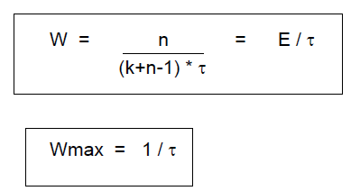
Throughput “W” - is the number of tasks that can be completed, by the pipeline, per unit time
» For a k-stage pipeline with a clock period t , n tasks take
(k+n-1) t time units

Slide 12
Design of a pipeline floating point adder. It is constructed in four stages. The inputs are
A = a x 2^{p}
B = b x 2^{q}
Where a and b are 2 fractions and p and q are their exponents and here base 2 is assumed.
To compute the sum
C = A+ B = c x 2^{r} = d x 2^{s}
Operations performed in the four pipeline stages are specified.
1. Compare the 2 exponents p and q to reveal the larger exponent r =max(p,q) and to determine their difference t =p-q.
2. Shift right the fraction associated with the smaller exponent by t bits to equalize the two components before fraction addition.

Slide 13
3. Add the preshifted fraction with the other fraction to produce the intermediate sum fraction c where 0 <= c <1.
4. Count the number of leading zeroes, say u, in fraction c and shift left c by u bits to produce the normalized fraction sum d = c x 2u, with a leading bit 1. Update the large exponent s by subtracting s= r – u to produce the output exponent.

Slide 14
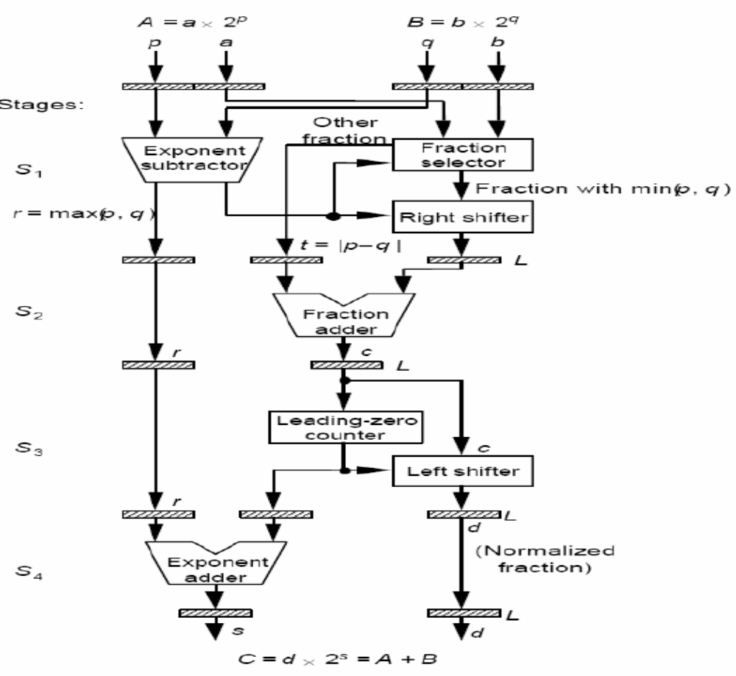

Slide 15
Classification of Pipeline Processors
Classification based on level of processing
Arithmetic Pipelining
The arithmetic and logic units of a computer can be segmentized for pipeline operations in various data formats. Well known arithmetic pipeline examples are
• Four stage pipes used in Star 100
• The eight stage pipes used in TI-ASC
• 14 pipeline stages used in Cray-1

Slide 16
Instruction Pipelining
The execution of a stream of instructions can be pipelined by overlapping the execution of the current instruction with fetch, decode and operand fetch of subsequent instructions.
This technique is known as instruction look-ahead.
Almost all HPCs are equipped with instruction-execution pipelines.

Slide 17
Processor pipelining
This refers to pipelining processing of the same data stream by a cascade of processors each of which processes a specific task.
The data stream passes the first processor with results stored in memory block which is also accessible by the second processor. The second processor then passes the refined results to the third and so on.

Slide 18
Pipeline classification schemes based on pipeline configurations and control strategies:
1. Unifunctional vs Multifunctional Pipelines
Pipelines with fixed & dedicated functions -> Unifunctional
Pipelines that can perform different functions, by interconnecting different subsets -> Multifunctional Pipelines
Ex: CRAY 1 has 12 unifunctional pipelines
TI-ASC has 4 Multifunctional Pipelines

Slide 19
2. Static Vs dynamic Pipelines
A static Pipeline may assume only one functional configuration at a time that is, static Pipeline can be either Unifunctional or Multifunctional Pipeline.
A dynamic Pipeline permits several functional configurations to exist simultaneously.
3. Scalar Vs Vector Pipelines
Classification made depending on the instruction or data type
A scalar pipeline processes a sequence of scalar operands.
A vector pipeline is designed to handle vector instructions over vector operands.

Slide 20
General Pipeline and Reservation Tables
The interconnection structures and data flow patterns in general pipelines are characterized by either feedforward or feedbackward connections, in addition to the cascaded connections in a linear pipeline.
A 2D chart known as reservation table shows how the successive pipelines stages are utilized for a specific function evaluation in successive pipeline cycles.
Reservation tables are used in successive pipeline stages which are utilized for a specific evaluation function.

Slide 21
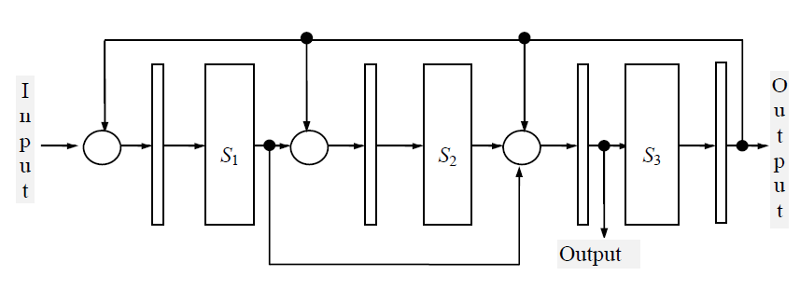

Slide 22
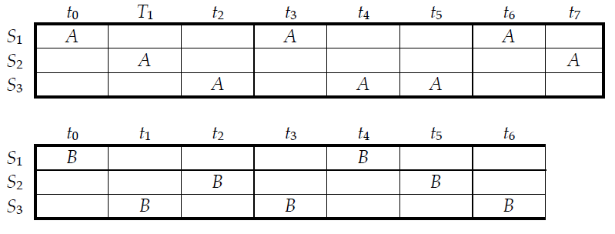
Consider an example of pipeline structure with both feedforward and feedback connections. The pipeline is dual functional denoted as function A and function B. The pipeline stages are numbered as S1, S2 and S3. The feed forward connection connects a stage Si to a stage Sj such that j ≥ i + 2 and feedback connection connects to Si to a stage Sj such that j <= i.
Rows correspond to pipeline stages and the columns time units.
Reservation Table for function A and B

Slide 23
The rows corresponds to pipeline stages and the columns to clock time units.
The total number of clock units in the table is called the evaluation time for the given function.
A reservation table represents flow of data through the pipeline or one complete evaluation of a given function.
A marked entry in the ( i,j)th square of the table indicates that stage Si will be used j time units after the initiation of the function evaluation.

Slide 24
The dataflow pattern in a static, unifunctional pipeline can be fully described by one reservation table.
A multifunctional pipeline may use different reservation tables for different functions to be performed.
It is possible to have multiple marks in a row or in a column. Multiple marks in a column corresponds to the simultaneous use of multiple pipelines stages. Multiple marks in a row corresponds to repeated usage of a given stage.

Slide 25
Instruction & Arithmetic Pipelines
Design of Pipelined Instruction Unit
IBM 360/91 is taken as example.
High degree of parallelism in instruction preprocessing and execution phases.
Specially designed for scientific computations in either fixed or floating point data formats.
Multiple pipeline functional units are built into the system to allow parallel arithmetic computations in either data format.

Slide 26
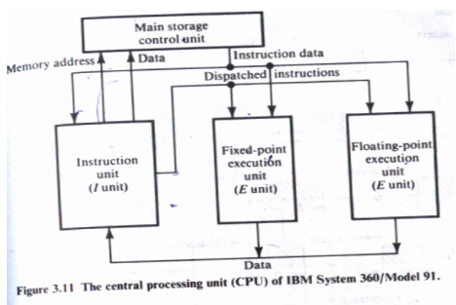

Slide 27
Storage unit: It controls the information interchange between the CPU and the main memory.
Instruction unit (I unit): The main function of this unit is instruction fetch, decode and delivery to the appropriate E unit. They also do operand fetch and operand address calculation.
Execution unit (E unit): floating-point and fixed-point arithmetic logic operations are done in this unit. The floating-point unit has a add unit and a multiply/divide which can operate in parallel.
The CPU issues instructions at a rate of one instruction cycle. This instructions are fed into the two E units and these E unit should support the rate.
Organizational techniques like parallel arithmetic functions, data buffering, internal forwarding and memory interleaving are used by model 91 to reduce the speed gap problems due to time disparities between instruction types(different instructions has different execution times)

Slide 28
Arithmetic Pipeline Design examples
The multiplication of 2 fixed point numbers is done by repeated add-shift operations, using ALU which has built in add and shift functions.
The number of add-shift operations required is proportional to the operand width. This sequential execution makes the multiplication a very slow process.
Multiple-number addition can be realized with a multilevel tree adder.
Carry propagation adder (CPA) adds two input numbers X and Y, to produce one output number, called sum X+Y
Carry save adder: Gets three inputs X,Y and Z and produces two outputs. Sum vector S and carry vector C

Slide 29
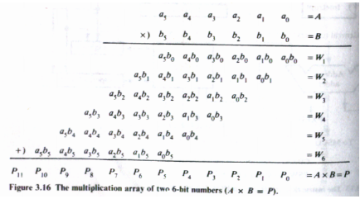

Slide 30
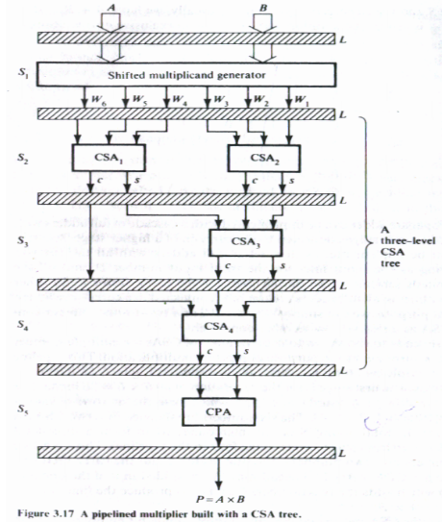

Slide 31
The first step in multiplying is generating all immediate product terms , this is done in S1. The six numbers thus generated are added to two CSA in S2. The CSA tree merges six numbers into two numbers: the sum vector S and the carry vector C (See from S2to S4 ). This Two numbers is given to the last stage CPA which adds the two numbers and produce the output.

Slide 32
Principles of Designing Pipeline Processors
I) Instruction Prefetch and Branch handling
The instruction in a program can be considered to be of four types
1.Arithmetic/load operations
2.Store type
3.Branch type
4.Conditional branch type
1. Arithmetic/load operations
The arithmetic/load operation constitute 60% of a program. They are data manipulation operations that needs one or two operand fetch.
Do not alter the sequential execution order of program.
2. Store type
These do not need operand fetch but memory access is needed.

Slide 33
3. Branch type
Branching is unconditional jumping.
May alter the PC in order to jump to a program location other than the next instruction. Hence these have devastating effect on the efficiency of the pipeline.
4. Conditional branch type
Conditional branching can have two paths ,yes or no. If the outcome is yes we need to calculate the new address and if no is the answer we can go to the next step in the sequence.
Interrupts and Branches
When instruction I is being executed, the occurrence of an interrupt postpones the execution of instruction I+1 until the interrupting request has been serviced.

Slide 34
There are two types of interrupts:
Precise interrupts : are caused by illegal operation codes found in instructions, which can be detected during the decoding stage.
Imprecise interrupts : are caused by defaults from storage, address and execution functions.
Precise interrupts on instruction I prohibits instruction I+1 from entering the pipeline, however those instruction that have not yet emerged from pipeline continue to run until the pipeline is drained. Then the interrupt routine is serviced.
An imprecise interrupt occurs usually when the instruction is halfway through the pipeline and subsequent instruction are already admitted into the pipeline. When an interrupt of this kind occurs, no new instructions are allowed to enter the pipe, but all incomplete instructions inside the pipeline will be completed before process unit is switched to service the interrupt.

Slide 35
A branch instruction entering the pipeline may be halfway down the pipe (case of successful conditional branch)before a branch decision is made. This will cause the program counter to be loaded with the new address to which the program should directed, making all prefetch instructions useless. The next instruction cannot be initiated until the completion of the current branch- instruction cycle.
Higher the percentage of branch-type instructions in a program, the slower the program will run on a pipeline processor.
Let p be the probability of a conditional branch instruction in a typical program and q be the probability that a branch is successful. Suppose m instructions are waiting to be executed through the pipeline. The number of instructions that cause successful branches equals m.p.q.
Then total instruction cycles required to process these m instructions (1/n)(n+m-1)+(m.p.q)(n-1)/n, where (n-1)/n is extra time delay needed for successful branch instruction.

Slide 36
There are two prefetch buffers of sizes s and t instruction words.
The s-size buffer holds instructions fetched during the sequential part of a run. When a branch is successful, the entire buffer is invalidated.
The t-size buffer holds instructions fetched from the target of a conditional branch. When a conditional branch is resolved and determined to be unsuccessful, the content of this buffer are invalidated.
If the instruction requested by the decoder is available in the sequential buffer for sequential instructions, or is in the target buffer if a conditional branch has just been resolved and is successful, it enters the decoder with zero delay. Otherwise decoder is idle until the instruction returns from memory.
  Except for jump instructions, all decoded instructions enter the execution pipeline, where E units are required to complete execution.
  If decoded instruction is an unconditional branch, the instruction word at the target of the jump is requested immediately by the decoder and decoding ceases until the target instruction returns from the memory.

Slide 37
If the decoded instruction is a conditional branch, sequential prefetching is suspended during the E cycles it is being executed. The instructions simultaneously enters the execution pipeline but no more instructions are decoded until the branch is resolved at the end of E units. Instructions are prefetched from the target memory address of the conditional branch instruction. Once the branch is resolved, target prefetching becomes unnecessary.
Instruction prefetch reduces the damaging effects of branching.

Slide 38
Memory System
(access time T)
Sequential
prefetch
Buffer(s words)
target
prefetch
Buffer(r words)
Decoder
(r time units)
1
an
2
n

Slide 39
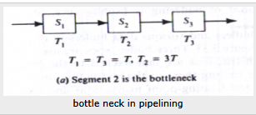
II)Data Buffering and Busing Structure
The processing speeds of pipeline segments are usually unequal.
Three stages S1,S2 and S3 shown in the picture. These three stages have different delays T1=T3=t and T2=3t.Here a bottleneck will be formed at T2.
The throughput of the pipeline is inversely proportional to the bottleneck. Hence it is desirable to remove the bottleneck which causes the unnecessary congestion.

Slide 40
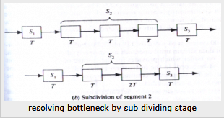
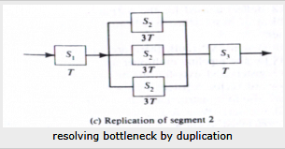
By subdividing the bottleneck the throughput can be increased. If the bottleneck is not sub divisible, using duplicates of the bottleneck in parallel can help. congestions.
The control and synchronization of tasks in parallel segments are more complex than those for cascaded segments.

Slide 41
Data and Instruction buffers
Buffering is a method to smooth the traffic flow in a pipeline.
Buffers are used to close up the speed gap between memory accesses for either instructions or operands and ALUs in the functional pipes.
The instruction or operand buffers provide a continuous supply of instructions or operands to the appropriate pipeline units.
Buffering can avoid unnecessary idling of the processing stages caused by memory access conflicts or by unexpected branching or interrupts.

Slide 42
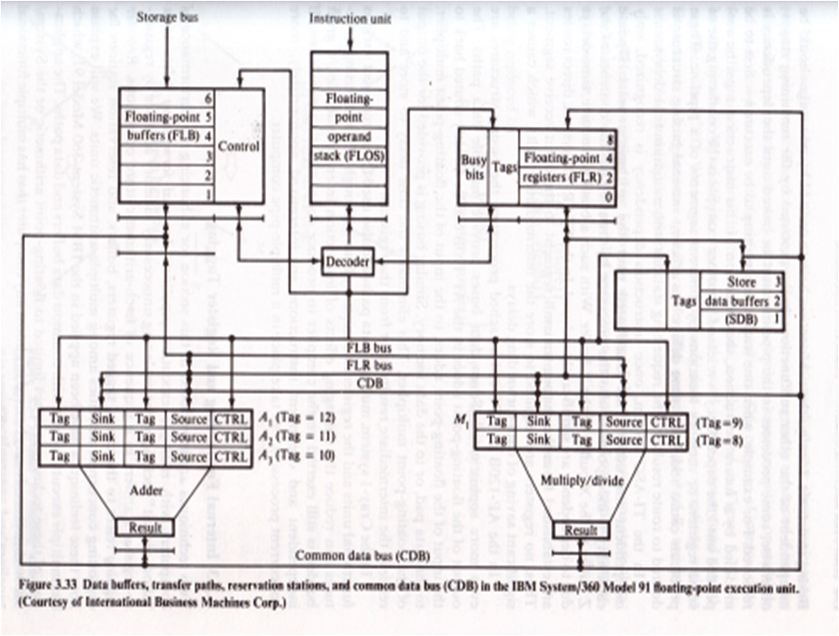

Slide 43
The use of instruction buffers and various data buffers in IBM System/360model 91
Three buffer types are used for various instruction and data types.
Instructions are first fetched to the instruction fetch buffers before sending them to the instruction unit.
After decoding, fixed and floating point instructions and data are sent to their dedicated buffers.
The store-address and data buffers are used for continuously storing results back to the main memory.
The storage-conflict buffers are used only when memory access conflicts are taking place.

Slide 44
Busing Structures
The subfunction being executed by one stage should be independent of the other subfunctions being executed by the remaining stages, otherwise, some processes in the pipeline must be halted until the dependency is removed.
The conflicting use of some registers or memory locations by different segments of a pipeline.
These problems cause additional time delays.
An efficient internal busing structure is desired to route results to the requesting stations with minimum delays.
The concepts of busing eliminates the time delay to store and to retrieve intermediate results to or from the registers.

Slide 45
In the AP 120B or FPS 164 attached processor the busing structure are even more sophisticated.
Seven data buses provide multiple data paths.
The output of the floating point adder in the AP 120B can be directly routed back to the input of the floating point adder, to the input of the floating point multiplier, to the data pad, or to the data memory.
Similar busing is provided for the output of the floating point multiplier.
This eliminates the time delay to store and to retrieve intermediate results or to from the registers.

Slide 46
Internal Forwarding and Register Tagging
To enhance the performance of computers with multiple execution pipelines two techniques are implemented
1. Internal Forwarding refers to a short circuit technique for replacing unnecessary memory accesses by register -to-register transfers in a sequence of fetch-arithmetic-store operations.
2. Register Tagging refers to the use of tagged registers, buffers and reservations stations for exploiting concurrent activities among multiple arithmetic units.
The computer performance can be greatly enhanced if one can eliminate unnecessary memory accesses and combine transitive or multiple fetch-store operations with faster register operations. This concept of internal data forwarding can be explored in three directions. The symbols Mi and Rj to represent the ith word in the memory and jth fetch, store and register-to register transfer. The contents of Mi and Rj are represented by (Mi) and Rj respectively.

Slide 47
Store-Fetch Forwarding
The following sequence of the two operations store-then- fetch can be replaced by 2 parallel operations,
one store and one register transfer.
2 memory accesses
Mi ←(R1) (Store)
R2 ← (Mi) (Fetch)
Is being replaced by
Only one memory access
Mi ← (R1) (store)
R2 ← (R1) (register Transfer)

Slide 48
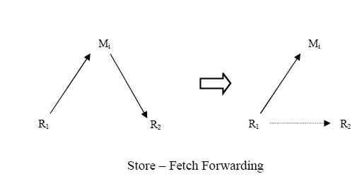

Slide 49
Fetch-Fetch Forwarding
The following fetch operations can be replaced by one fetch and one register transfer. One memory access has been eliminated.
2 memory accesses
R1 ← (Mi) (fetch)
R2 ← (Mi) (Fetch)
Is being replaced by
Only one memory access
R1 ←(Mi) (Fetch)
R2 ← (R1) (register Transfer)

Slide 50
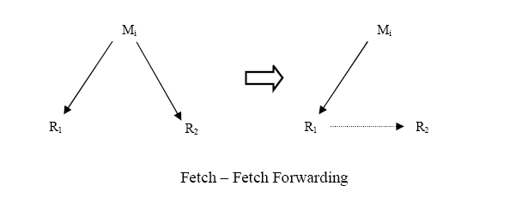

Slide 51
Store-Store Overwriting
The following two memory updates of the same word can be combined into one, since the second store overwrites the first.
2 memory accesses
Mi ←(R1) (store)
Mi ← (R2) (store)
Is being replaced by
Only one memory access
Mi ←(R2) (store)
The above steps shows how to apply internal forwarding to simplify a sequence of arithmetic and memory access operations

Slide 52
Mi
Mi
R1
R2
R2

Slide 53
In IBM model 91 the data registers, transfer paths, floating-point adder and multiply-divide units, reservation stations and the common data bus are there.
Three reservation stations for adder(A1,A2,A3) and two for multiply-divide unit (M1,M2) are able to hold operands for the next execution while the functional units is busy executing current instruction.
The three store data buffers (SDB) and four floating-point registers (FLR) are all tagged. The busy bits in the FLRs marks their status which can be used to determine the dependence of instructions in subsequent execution.
This common data busing and register-tagging scheme permits simultaneous execution of independent instructions while preserving the essential precedence inherent in the instruction stream.
The CDB can function with any number of execution units and any number of accumulators.

Slide 54
Hazard Detection and Resolution
A pipeline hazard refers to a situation in which a correct program ceases to work correctly due to implementing the processor with a pipeline.
Pipeline hazards are caused by resource-usage conflicts among various instructions in the pipeline. Such hazards are triggered by interinstruction dependencies.
There are three fundamental types of hazard:
• Data hazards,
• Branch hazards, and
• Structural hazard

Slide 55
Data Hazards
This is when reads and writes of data occur in a different order in the pipeline than in the program code.
There are four different types of data hazard (named according to the order of operations that must be maintained):
    Write After Read
    Write After Write
    Read After Write
    Read After Read
    Read After Read does not pose any problem, because nothing is changed.

Slide 56
Resource objects are used to refer working registers, memory locations and special flags. The contents of these resource objects are called data objects.
The domain D(I) of an instruction I is the set of resource objects whose data objects may affect the execution of instruction I.
The range R(I) of an instruction I is the set of resource objects whose data objects may be modified by the execution of instruction I.
The instruction J appears after the execution of instruction I in the program and there may be no instructions between these two instructions.

Slide 57
RAW hazard
A RAW hazard between the two instruction I and J may occur when J attempts to read some data object that has been modified by I.
Instruction I
R(I)
D(I)
D(J)
Instruction J
(write)
R(J)
(read)

Slide 58
WAR hazard
A WAR hazard between the two instruction I and J may occur when J attempts to modify some data object that is read by I.
Instruction J
R(J)
D(J)
D(I)
Instruction I
(write)
R(I)
(read)

Slide 59
WAW hazard
A WAW hazard between the two instruction I and J may occur if both I and J attempt to modify same data object.
Instruction I
R(I)
D(I)
R(J)
Instruction J
(write)
D(J)
(write)

Slide 60
  R(I) ∩ D(J) ≠ Φ for RAW
  D(I) ∩ R(J) ≠ Φ for WAR
  R(I) ∩ R(J) ≠ Φ for WAW

Slide 61
Resolving Hazards
Once hazard is detected, the system should resolve the interlock situation.
Consider the instruction sequence {…I,I+1,…J,J+1,…} in which hazard has been detected between the current instruction J and a previous instruction I. A straight forward approach is to stop the pipe and to suspend the execution of instructions J,J+1,…, until the instruction I has passed the point of resource conflict.
A more sophisticated approach is to suspend only instruction J and continue the flow of instructions J+1,J+2…. move ahead of J.
In order to avoid RAW hazards, a short-circuiting approach is developed, which gives a copy of the data object to be written directly to the instruction waiting to read the data. This concept is known as data forwarding, which forwards multiple copies of the data to as many waiting instructions as may wish to read it.
The internal forwarding and register-tagging resolves logical hazards in pipelines.

Slide 62
Job Sequencing and Collision Prevention
The job sequencing problem is to properly schedule queued tasks awaiting initiation in order to avoid collisions and to achieve high throughput. A collision occurs when two or more initiations attempt to use the same stage at the same time.
The reservation table identifies the space-time flow pattern of one complete data through the pipeline for one function evaluation.
In static pipeline all initiations are characterized by the same reservation table. In dynamic pipeline a set of reservation tables are used for one per each function being evaluated.

Slide 63
The number of time units between two initiations is called latency, which may be any positive integer.
For a static pipeline, the latency is usually one, two or greater. Zero latency is allowed in dynamic pipelines between different functions.
The sequence of latencies between successive initiations is called latency sequence. A latency sequence that repeats itself is called a latency cycle.
A control strategy that always minimizes the latency between the current initiation and very last initiation is a called a greedy strategy.

Slide 64
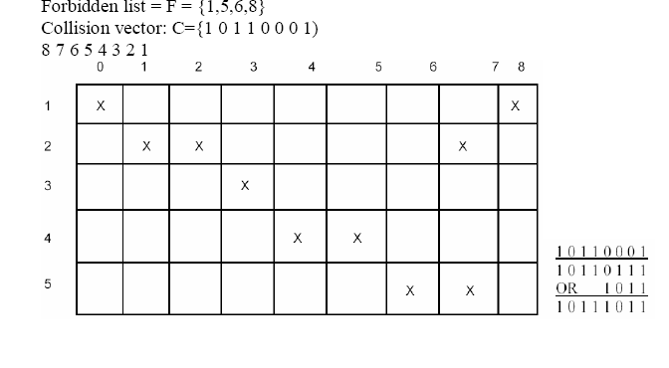

Slide 65
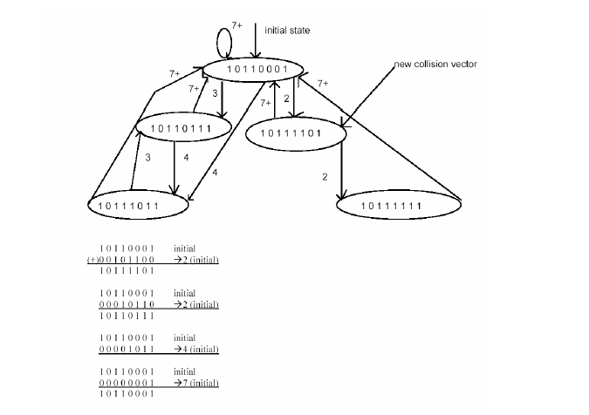

Slide 66
The collision vector shows both permitted and forbidden latencies from the same reservation table.
One can use n-bit shift register to hold the collision vector for implementing a control strategy for successive task initiations in the pipeline. Upon initiation of the first task, the collision vector is parallel-loaded into the shift register as the initial state. The shift register is then shifted right one bit at a time, entering 0’s from the left end. A collision free initiation is allowed at time instant t+k, if and only if a bit 0 is being shifted out of the register after k shifts from time t.
A state diagram is used to characterize the successive initiations of tasks in the pipeline in order to find the shortest latency sequence to optimize the control strategy. A state on the diagram is represented by the contents of the shift register after the proper number of shifts is made, which is equal to the latency between the current and next task initiations.

Slide 67
The successive collision vectors are used to prevent future task collisions with previously initiated tasks, while the collision vector C is used to prevent possible collisions with the current task. If a collision vector has a “1” in the i^{th} bit (from the right), at time t, then the task sequence should avoid the initiation of a task at time t+i.
Closed loops or cycles in the state diagram indicate the steady – state sustainable latency sequence of task initiations without collisions.
The average latency of a cycle is the sum of its latencies (period) divided by the number of states in the cycle.
The throughput of a pipeline is inversely proportional to the reciprocal of the average latency.
A latency sequence is called permissible if no collisions exist in the successive initiations governed by the given latency sequence.
The maximum throughput is achieved by an optimal scheduling strategy that achieves the (MAL) minimum average latency without collisions.

